Slide 1
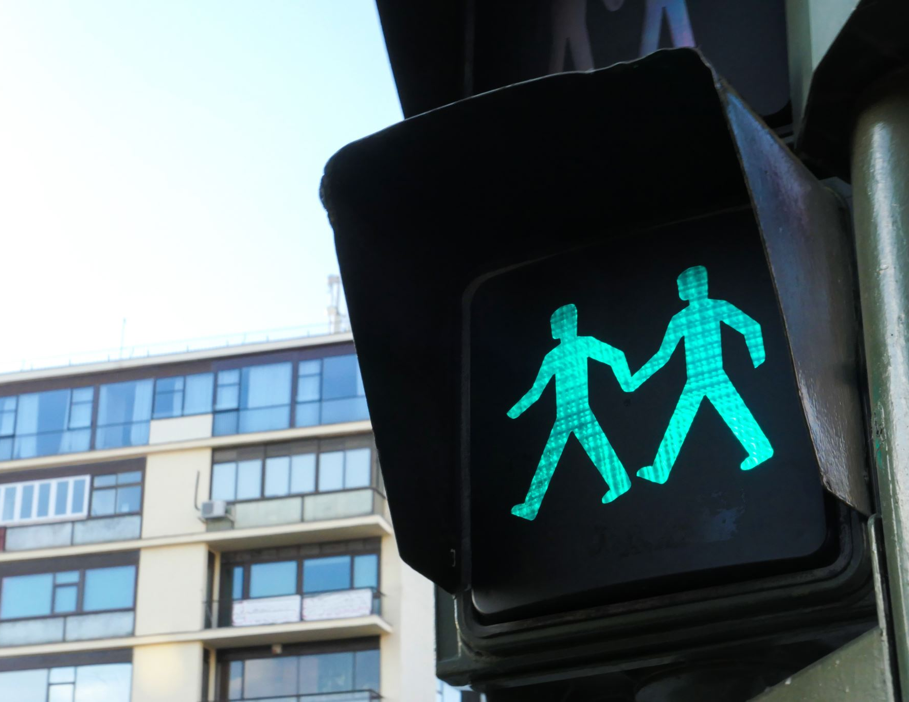
On-Demand Traffic Light Control
Done by:
Mohamed Salah Abd-Allah

Slide 2

Table of content:
System description
System design:
  Project’s file structure
System flow chart

Slide 3
System description
The system is responsible to handle both car and pedestrian traffic. The system will have 2 modes:
1- Normal Mode:
In this Mode, the light traffic will handle cars and pedestrians automatically without any interruptions as:
• Cars' LEDs will be changed every five seconds starting from Green then yellow then red then yellow
then Green.
• The Yellow LED will blink for five seconds before moving to Green or Red LEDs.
2- Pedestrian mode:
This mode is for pedestrian to interrupt the system by pressing a button so, the system will change its
operating system to Pedestrian mode. The transaction scenario will be handled as follow:
• Change from normal mode to pedestrian mode when the pedestrian button is pressed.
• If pressed when the car’s Red LED is on, the pedestrian's Green LED and the car’s Red LEDs will
be on for five seconds, this means that pedestrians can cross the street while the pedestrian's Green
LED is on.
• If pressed when the car’s Green LED is on or the car’s Yellow LED is blinking, the pedestrian Red
LED will be on then both Yellow LEDs start to blink for five seconds, then the cars' Red LED and
pedestrian Green LEDs are on for five seconds, this means that pedestrian must wait until the Green
LED is on.
• At the end of the two states, the cars' Red LED will be off and both Yellow LEDs start blinking for 5
seconds and the pedestrian's Green LED is still on.
• After five seconds the pedestrian Green LED will be off and both the pedestrian Red LED and the
cars' Green LED will be on.
• Traffic lights signals are going to the normal mode again.

Slide 4
System design: following the layered architecture concept
APP layer
ECUAL
MCAL
Application
LED
BUTTON
DIO
Timer
Interrupt

Slide 5
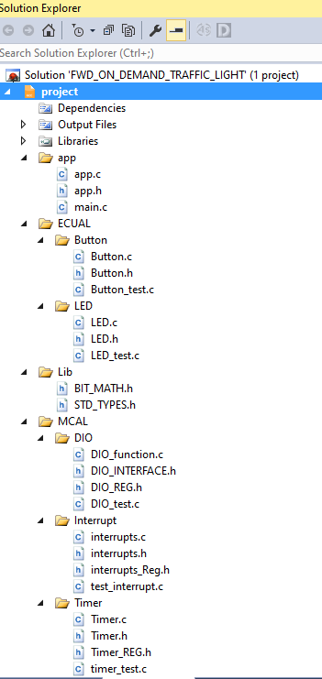
Project’s folder structure:

Slide 6
Flow-chart Of The App:
START
Normal mode
PED button = TRUE
NO
YES
Car RED LED=TRUE
Pedestrian's Green LED and the cars' Red LEDs will be on for five seconds,
YES
NO
the pedestrian Red LED will be on then both Yellow LEDs start to blink for five seconds
cars' Red LED will be off and both Yellow LEDs start blinking for five seconds and the pedestrian's Green LED is still on.
Cars' Red LED and pedestrian Green LEDs are on for five seconds
Green LED will be off and both the pedestrian Red LED and the cars' Green LED will be on.

